Slide 1

Course Title: Data Communication
Course Code : CSE233

Slide 2
TOPIC
The OSI Model
Open Systems Interconnection Model
102-15-1030

Slide 3
What is OSI model???
OSI is a set of internationally recognized, non-proprietary standards for networking and for operating system involved in networking functions.
102-15-1030

Slide 4
History of OSI Model
Established in 1947
Standard Model for Data Communications
Specified by ISO
It was first introduced in the late 1970s
102-15-1030

Slide 5
The OSI Model
The OSI model allows any two different systems to communicate regardless of their underlying architecture (hardware or software).
The OSI model is not a protocol; it is model for understanding and designing a network architecture that is flexible, robust and interoperable.
102-15-1030

Slide 6
Layers of the OSI model
Seven Layers
Each Layer Performs a Unique Function
Each Layer Has Its Own Protocol
Protocol Messages in Upper Layer is Data to Layer Below
102-15-1030

Slide 7
Seven Layers of the OSI model
All
People
Seem
To
Need
Data
Processing
Application Layer
Presentation Layer
Session Layer
Transport Layer
Network Layer
Data Link Layer
Physical Layer
102-15-1030

Slide 8
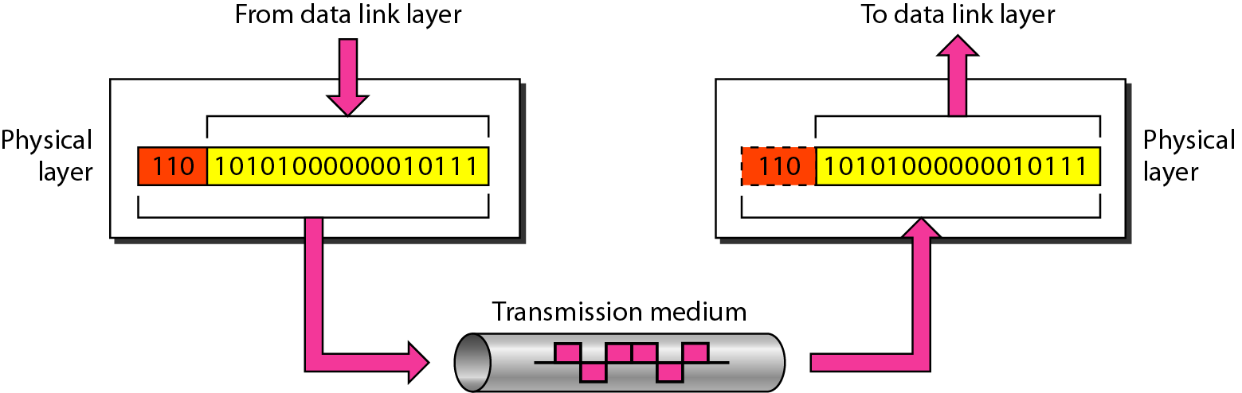
Physical Layer
The physical layer is responsible for movements of individual bits from one hop (node) to the next.
102-15-1030

Slide 9
Major duties of Physical layer
Physical characteristics of interfaces and medium
Representation of bits
Data rate : transmission rate
Synchronization of bits
Line configuration
Physical topology
Transmission mode
102-15-1030

Slide 10
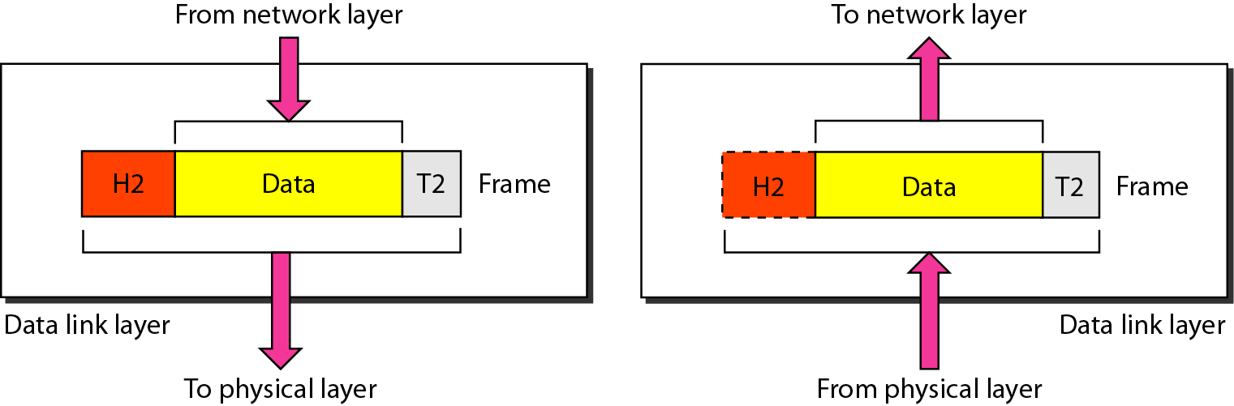
Data Link Layer
The data link layer is responsible for moving frames from one hop (node) to the next.
102-15-1030

Slide 11
Major duties of Data Link Layer
Framing
Physical addressing
Flow control
Error control
Access control
102-15-1030

Slide 12
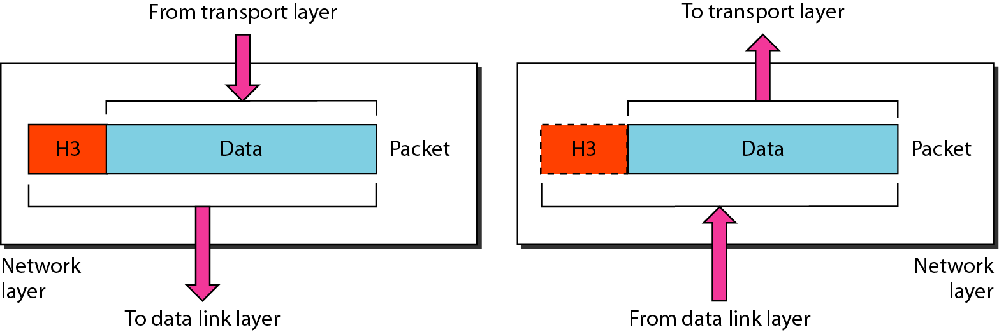
Network Layer
The network layer is responsible for the delivery of individual packets from the source host to the destination host.
1.Logical addressing and 2.Routing
102-15-1030

Slide 13
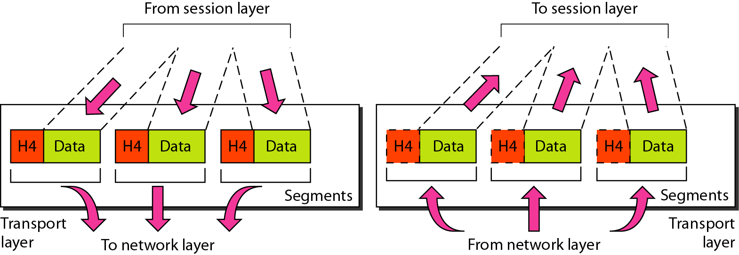
Transport Layer
The transport layer is responsible for the delivery of a message from one process to another.
102-15-1030

Slide 14
Major duties of Transport Layer
Service-port addressing
Segmentation and reassembly
Connection control
Flow control
Error control
102-15-1030

Slide 15
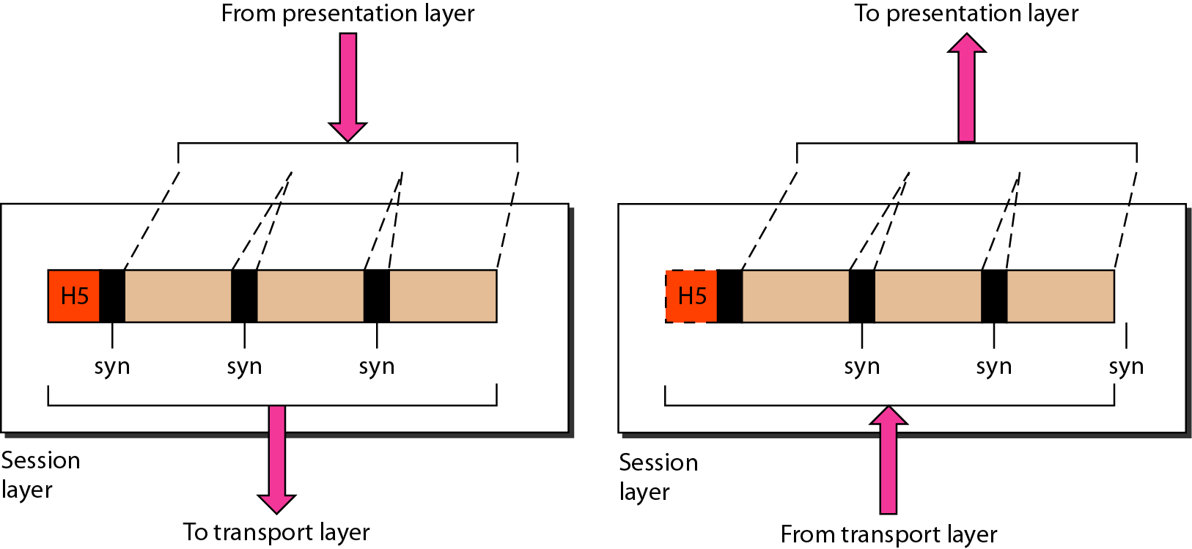
Session Layer
The session layer is responsible for dialog control and synchronization.
102-15-1030

Slide 16
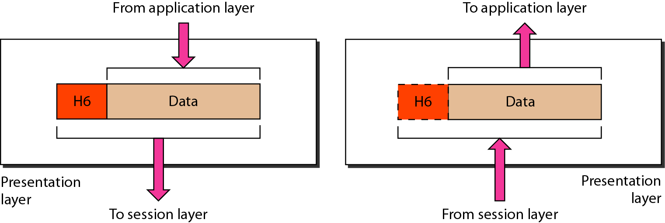
Presentation Layer
The presentation layer is responsible for translation, compression, and encryption
102-15-1030

Slide 17
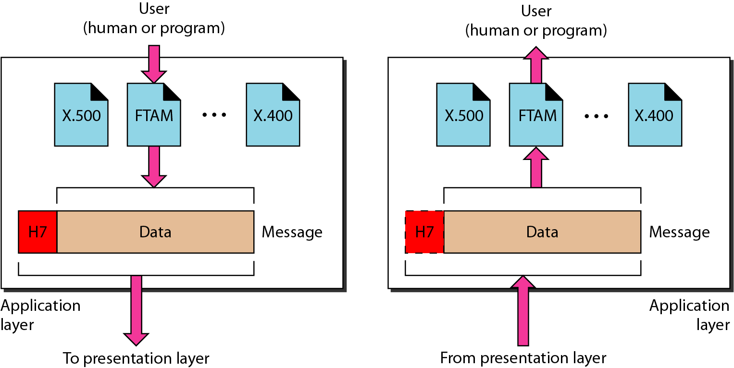
Application Layer
The application layer is responsible for providing services to the user.
102-15-1030

Slide 18
The major duties of the application
Network virtual terminal
File transfer, access, and management
Mail services
Directory services
102-15-1030

Slide 19
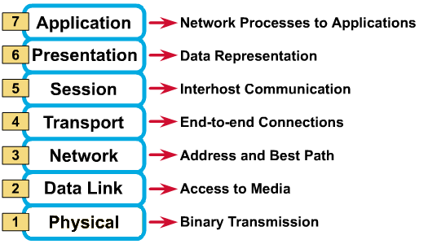
Seven Layers of the OSI model
102-15-1030

Slide 20
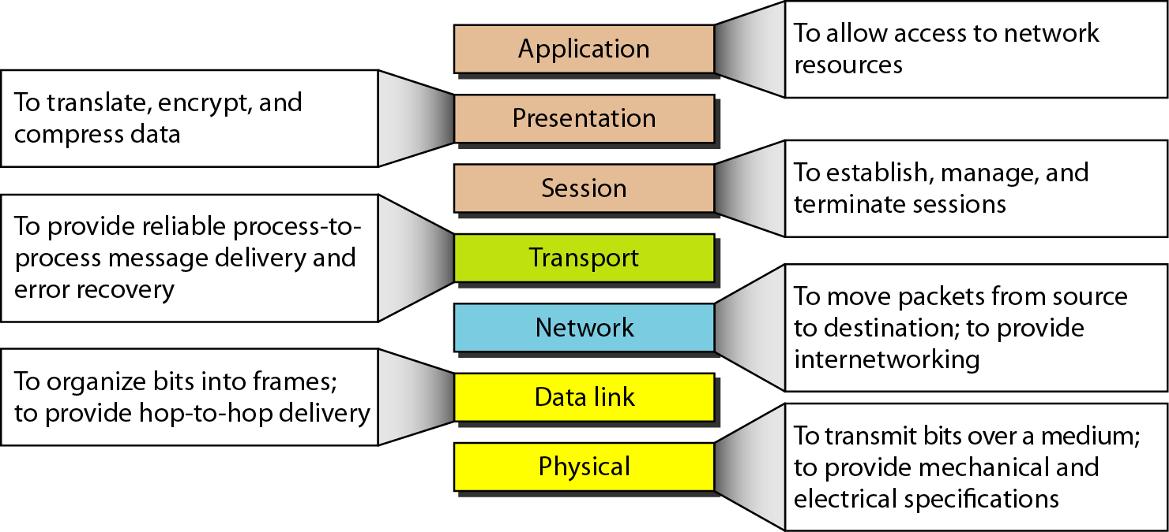
Summary of Layers
102-15-1030

Slide 21
END

